Slide 1
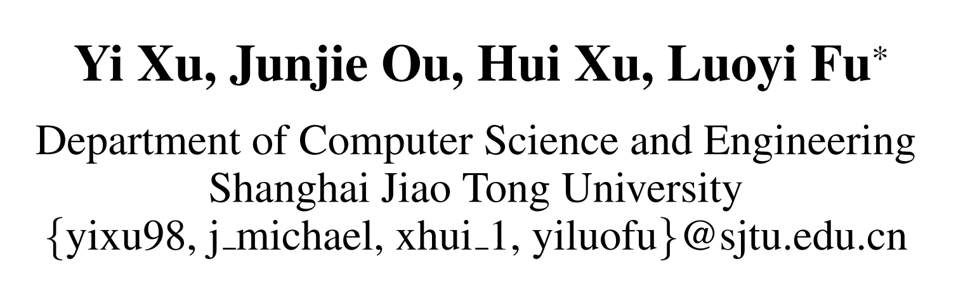
Chongqing University of Technology
Temporal Knowledge Graph Reasoning with
Historical Contrastive Learning
Reported by Dawei Wang
—— AAAI 2023

Slide 2
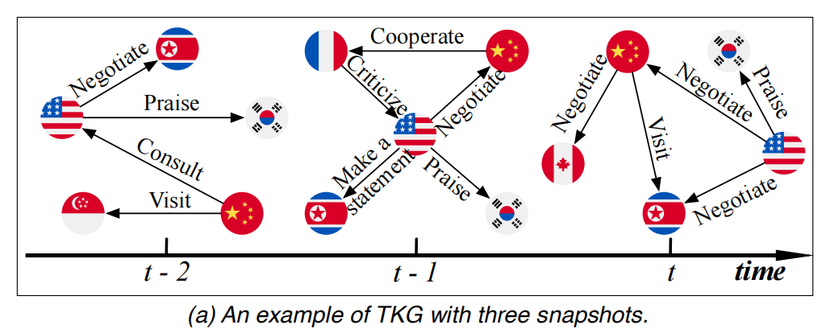
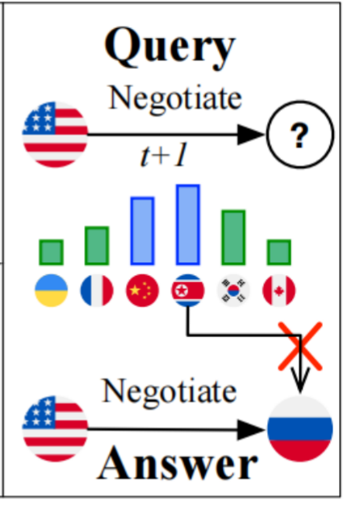
Chongqing University of Technology
Introduction
Most existing methods of TKG often obtain incorrect results over such query due to their focus on the high frequent recurring events.

Slide 3
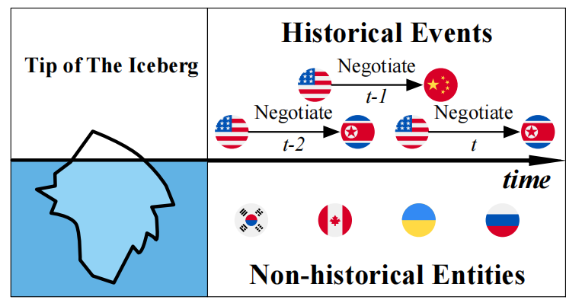
Chongqing University of Technology
Introduction
The fact is that events in TKG are not only related to their historical events but also indirectly related to unobserved underlying factors.

Slide 4
Chongqing University of Technology
Introduction
In this work, the authors go beyond the limits of historical information and mine potential temporal patterns from the whole knowledge.
For that, the authors proposed a novel TKG reasoning model called CENET(Contrastive Event Network) for event forecasting based on contrastive learning.

Slide 5
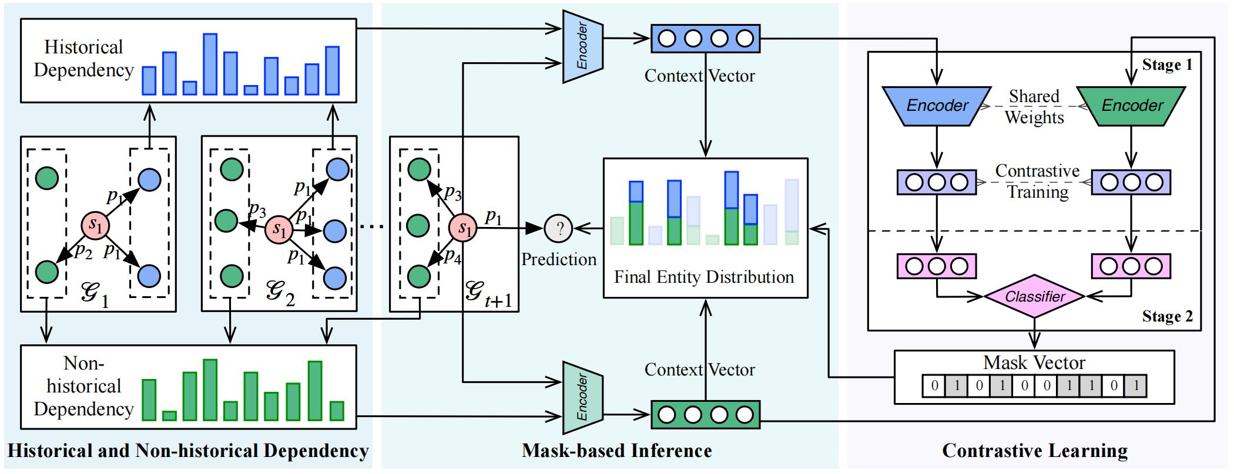
Chongqing University of Technology
s: subject entity
p: relation
o: object entity
The overall architecture of CENET
TKG with timestamps ranging from t₁ to t_{n}

Slide 6
Chongqing University of Technology
s: subject entity
p: relation
o: object entity
The overall architecture of CENET
t_{n+1}:query(s₁, p₁, ? ,n+1)

Slide 7
Chongqing University of Technology
s: subject entity
p: relation
o: object entity
The overall architecture of CENET
the importance of each entities

Slide 8
Chongqing University of Technology
s: subject entity
p: relation
o: object entity
The overall architecture of CENET
CENET generates a latent context vector for query q, which scores the historical or non-historical dependency of different object entities

Slide 9
Chongqing University of Technology
s: subject entity
p: relation
o: object entity
The overall architecture of CENET
encoding by an MLP with same weights to generate embedding vector

Slide 10
Chongqing University of Technology
s: subject entity
p: relation
o: object entity
The overall architecture of CENET
supervised contrastive learning: to make the representations of the same category closer, which means the model can identify the historical events which related with query q

Slide 11

Chongqing University of Technology
s: subject entity
p: relation
o: object entity
The overall architecture of CENET
the model feeds embedding vector v_{q} to a linear layer to train a binary classifier, which generate a boolean mask vector $B_{t}^{s,p}(o)$ to identify which kind of entities should be concerned.

Slide 12
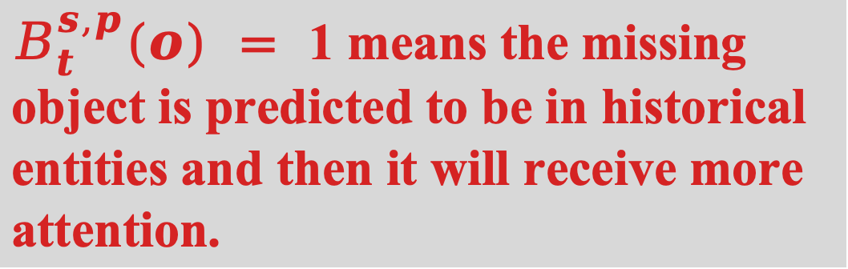
Chongqing University of Technology
s: subject entity
p: relation
o: object entity
The overall architecture of CENET
$B_{t}^{s,p}(o) =$1 means the missing object is predicted to be in historical entities and then it will receive more attention.

Slide 13
Chongqing University of Technology
s: subject entity
p: relation
o: object entity
The overall architecture of CENET
CENET conbines the softmax result of the above two latent vectors as the predicted probabilities
softmax

Slide 14
Chongqing University of Technology
s: subject entity
p: relation
o: object entity
The overall architecture of CENET
final entity distribution P(o|s,p,F) = P * B
CENET will choose the object with the highest probability as the final prediction o
o = argmax P(o|s,p,F)
P
softmax
B

Slide 15
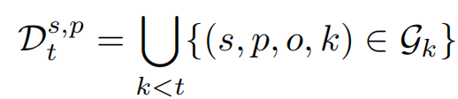

Chongqing University of Technology
Definitions and Equations
s: subject entity
p: relation
o: object entity
t : timestamp
1. the set of historical events:
2. the corresponding set of historical entities:

Slide 16
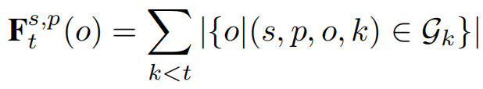

Chongqing University of Technology
Definitions and Equations
s: subject entity
p: relation
o: object entity
t : timestamp
Φ _{β}= 1 when β is true
Φ _{β}= 0 when β is false
3. the frequencies of all entities:
4. transform $F_{t}^{s,p}$ to $Z_{t}^{s,p}$:

Slide 17
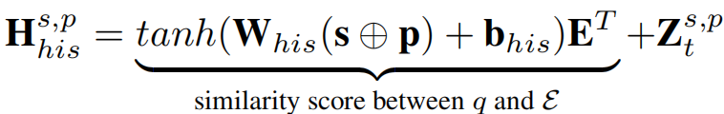
Chongqing University of Technology
tanh: activation function
W_{his} and b_{his} : trainable parameters
E: embeddings of all entities
Definitions and Equations
5. the latent context vector for historical dependency:
6. the latent context vector for non-historical dependency:

Slide 18


Chongqing University of Technology
Definitions and Equations
s: subject entity
p: relation
o: object entity
t : timestamp
7. the predicted probabilities(distribution):
8. the embedding vector of the given query q:

Slide 19
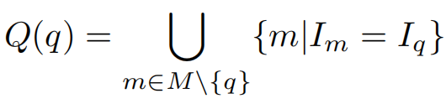
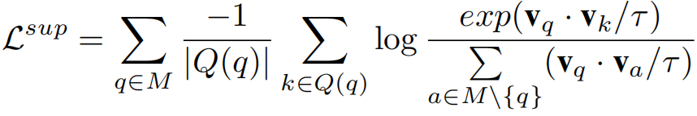

Chongqing University of Technology
Φ _{β}= 1 when β is true
Φ _{β}= 0 when β is false
Definitions and Equations
9. the supervised contrastive loss:
10. boolean mask vector:

Slide 20



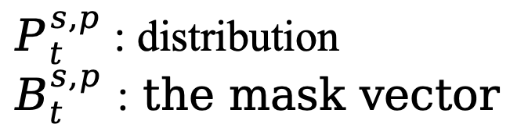
Chongqing University of Technology
$P_{t}^{s,p}$ : distribution
$B_{t}^{s,p}$ : the mask vector
Definitions and Equations
11. the probabilities of object entities:
12. the final prediction :

Slide 21
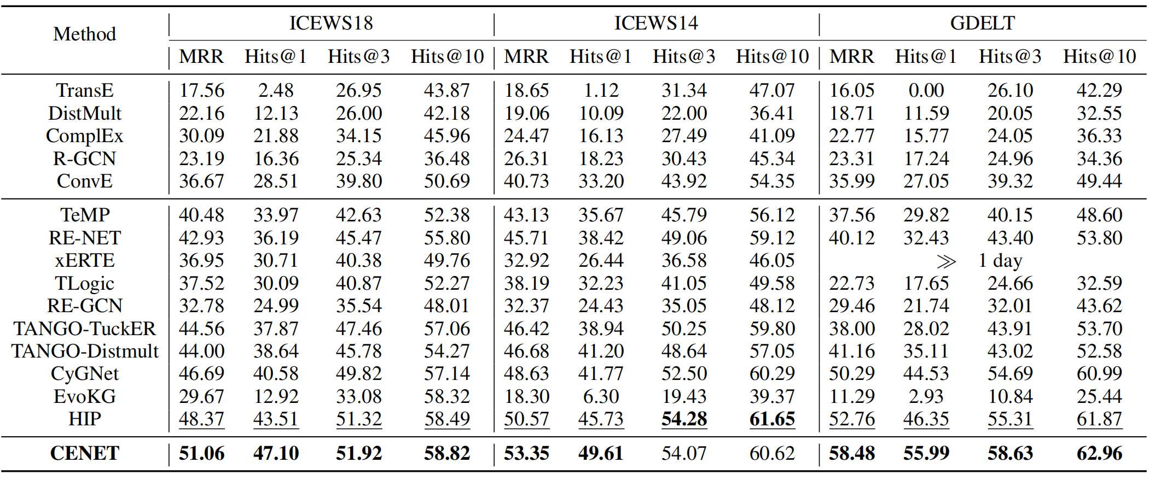
Chongqing University of Technology
three event-based TKGs datasets: ICEWS18、ICEWS14、GDELT
Experiments
the results of previous SOTAs

Slide 22
Chongqing University of Technology
three event-based TKGs datasets: ICEWS18、ICEWS14、GDELT
Experiments
the results of previous SOTAs
CENET is better

Slide 23
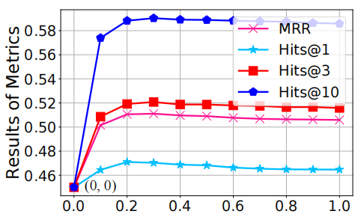
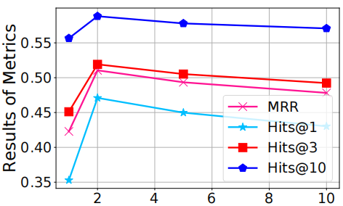
Chongqing University of Technology
Experiments
Hyper-parameter α on ICEWS18
Hyper-parameter λ on ICEWS18

Slide 24
Chongqing University of Technology
Thanks！

